Slide 1


Visvesvaraya Technological University, beLAGAVI-590014
DAYANANDA SAGAR ACADEMY OF TECHNOLOGY AND MANAGEMENT
Udayapura, Kanakapura Road, Bangalore-560082
Department of Electronics and Communication Engineering
MAJOR PROJECT PRESENTATION
PROJECT TITLE:
“SIGN LANGUAGE IDENTIFICATION USING DEEP LEARNING”
Submitted by
MEDHA R(1DT19EC045)
NADEEM ABDUL RAZAK GULAM(1DT19EC048)
NEHA PANDEY(1DT19EC051)
RAKSHITH V K(1DT19EC060)
Under the Guidance of
Dr. Vasudeva G
(Asst. Professor, Dept. of ECE)

Slide 2

01
TITLE
02
BLOCK DIAGRAM
04
METHODOLOGY
05
OUTLINE
06
PROJECT IMPLEMENTATION
OBJECTIVES
07
EXPERIMENTAL RESULTS
03
08
QUALITY METRICS
09
CONCLUSION
10
REFERENCE
SOFTWARE AND HARDWARE

Slide 3


SIGN LANGUAGE IDENTIFICATION USING DEEP LEARNING
13082000
13082000

Slide 4

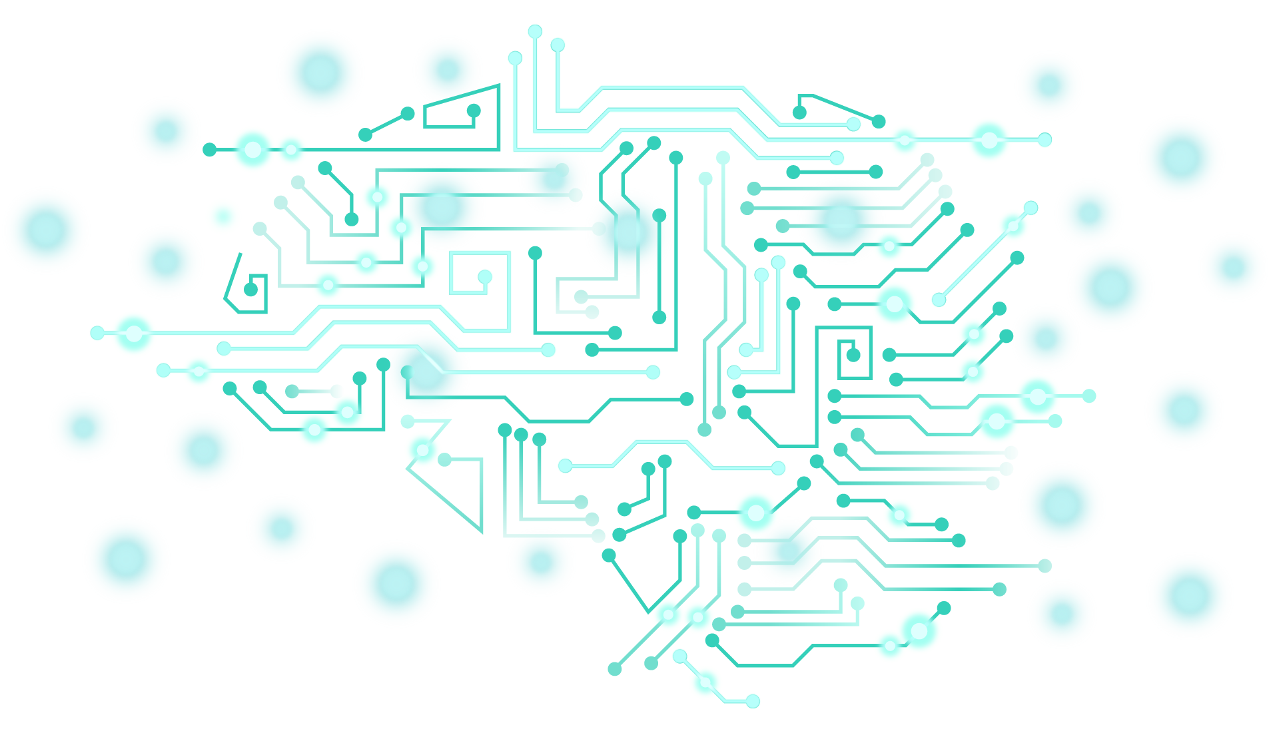
PROBLEM STATEMENT
PROBLEM STATEMENT
Several people with disabilities around the world are not able to carry out basic day to day tasks due to hindrances caused by their disability. Our system will aim to solve some of their problems.
Several people with disabilities around the world are not able to carry out basic day to day tasks due to hindrances caused by their disability. Our system will aim to solve some of their problems.

Slide 5
OBJECTIVES
to create our own dataset for training and testing purpose
To develop a Deep learning model that can classify various hand gestures used for fingerspelling in sign language.
To improve the accuracy of the model by pre-training it on an image dataset.
to utilize the Hunspell_suggest a python library to implement an AutoCorrect and to give possible words.

Slide 6


BLOCK DIAGRAM
Image Acquisition
Hand detecting
And tracking
Camera
Training
Feature
Extraction
Preprocessing
Training
Database
Recognition
Example
Output
(text)

Slide 7
EXISTING METHODOLOGY
According to base paper the existing methodology is for Japanese sign language identification
They have used machine learning.
For feature extraction they have used classification tree
And they have achieved the accuracy of 86%.

Slide 8
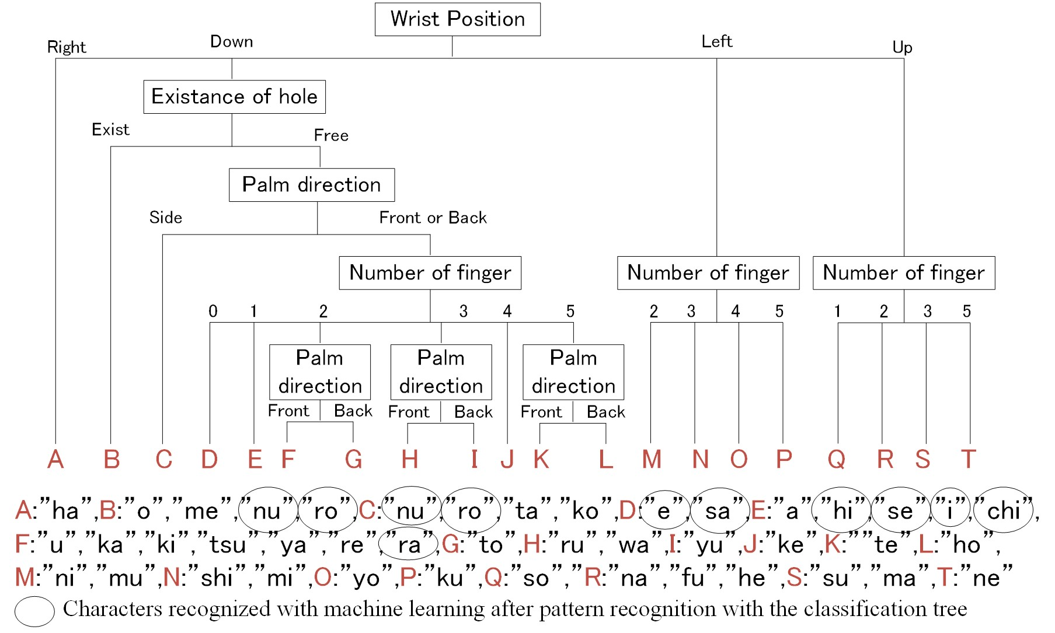
EXISTING METHODOLOGY

Slide 9
PROPOSED METHODOLOGY
We have implemented this for ASL(American sign language )
We have come up with the Deep learning model.
For feature extraction we have used gaussian blur filter.
And we have achieved 98% accuracy using 2 layer model .

Slide 10
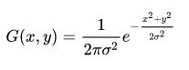
METHODOLOGY
DATA SET GENERATION
We have created our own dataset, which is 700 images of each symbol for each symbol and 200 images each for testing.
For this purpose, OpenCV library is used to produce the dataset. Each frame is captured by the webcam and a ROI that is region of interest that is bounded by a blue square is defined.
Then , we apply the Gaussian blur filter using Open CV to our image which helps extract the various features of the image.
The Gaussian filter is a low-pass filter that removes the high-frequency components are reduced.
x and y specify the delta from the center pixel (0, 0). For example, if the selected radius for the kernel was 3, x and y would range from -3 to 3

Slide 11
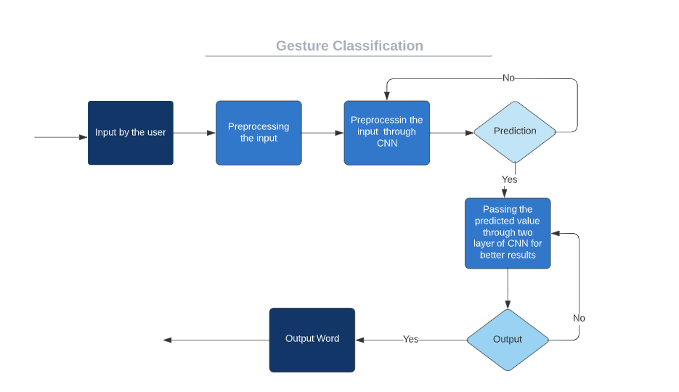
GESTURE CLASSIFICATION
CNN Layer 1:
Apply Gaussian Blur filter and threshold to the frame taken with openCV to get the processed image after feature extraction.
This processed image is passed to the CNN model for prediction and if a letter is detected for more than 50 frames then the letter is printed and taken into consideration for forming the word.
Space between the words is considered using the blank symbol.
CNN Layer 2:
We detect various sets of symbols which show similar results on getting detected.
We then classify between those sets using classifiers made for those sets only.
CNN

Slide 12


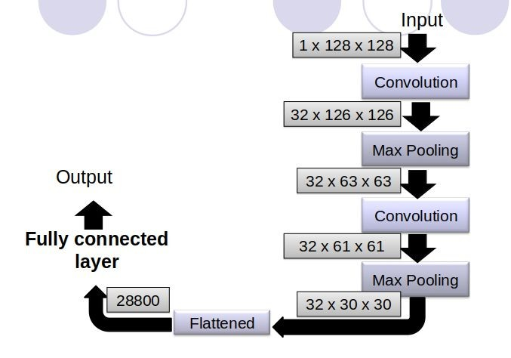
Convolution Layer
The layer consists of learnable filters of window size and compute the dot product of filter entries and input values at a given position.
Pooling Layer
Fully Connected Layer
In a fully connected region ,we will connect all the inputs to neurons.
Final Output Layer
After getting values from fully connected layer , we will connect them to the final layer of neurons.

Slide 13
SOFTWARE AND HARDWARE TOOLS USED
Python 3.6.6
TensorFlow 1.11.0
OpenCV 3.7.0
NumPy 1.15.3
Matplotlib 3.0.0
Hunspell 2.0.2
Keras 2.2.1
Camera: Good quality, 3MP, Ram: Minimum 8GB or higher , GPU: 4GB dedicated ,Processor: Intel Pentium 4 or higher

Slide 14
PROJECT IMPLEMENTATION

Slide 15
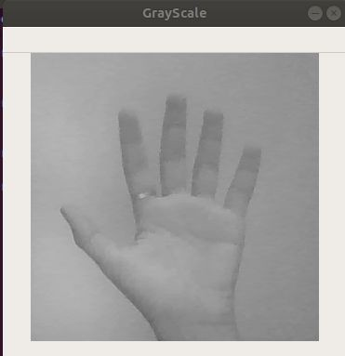
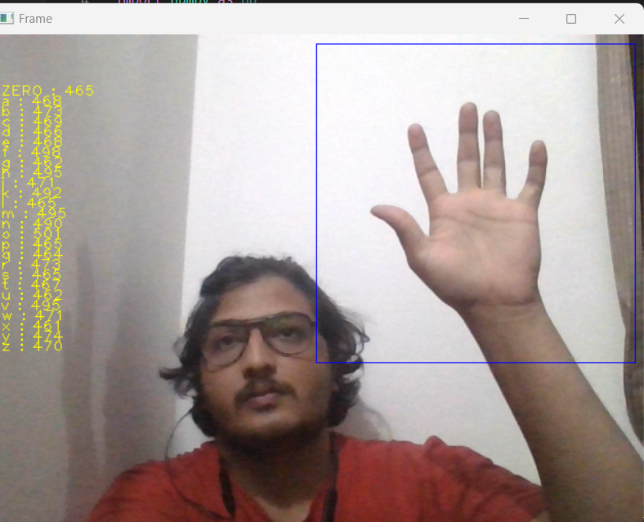
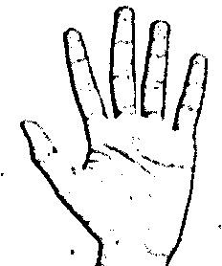
PROJECT IMPLEMENTATION
Capturing Raw Image
Image Post Gaussian Blur
Gray Scale Image

Slide 16
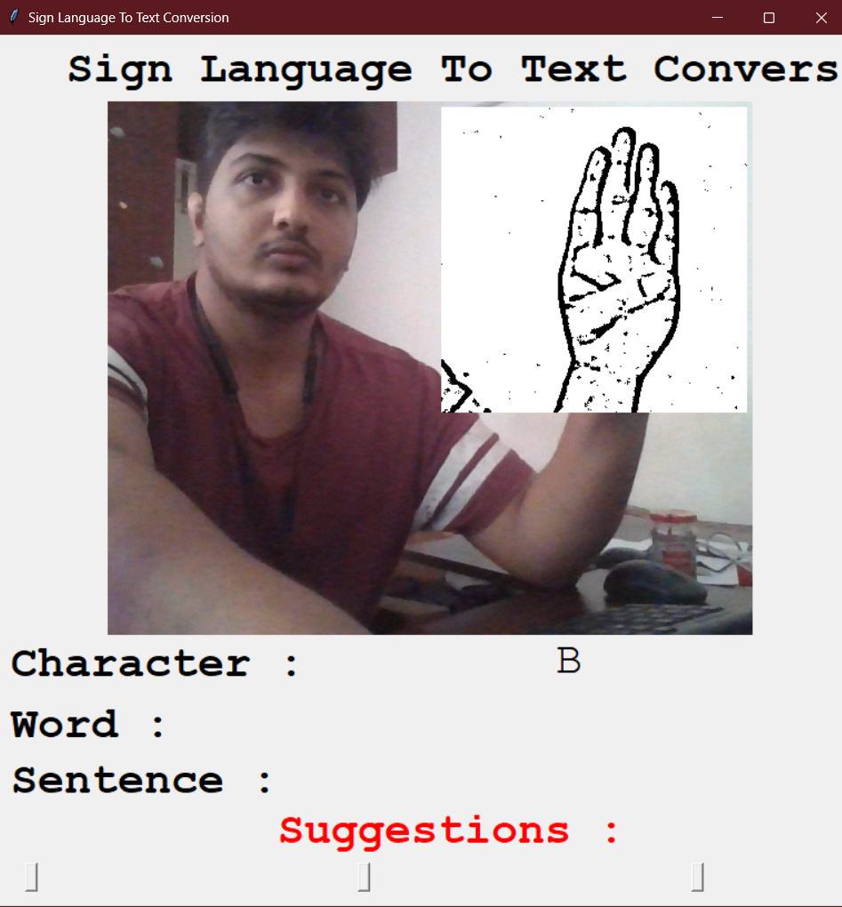
CUSTOM BUILT GUI

Slide 17
EXPERIMENTAL RESULTS

Slide 18
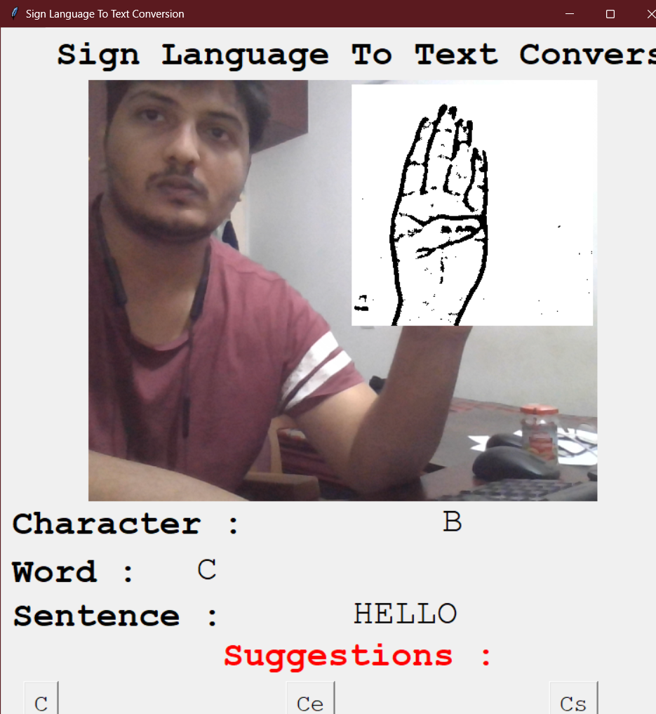
Word Formation

Slide 19
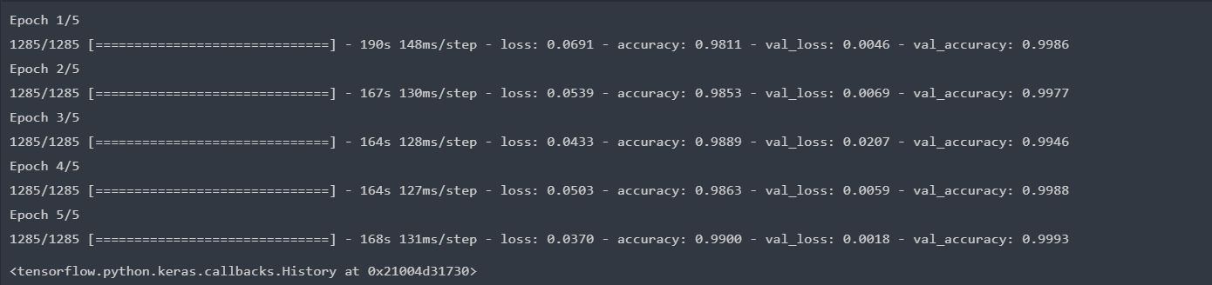
PERFORMACE MEASURES
ACCURACY:98%

Slide 20
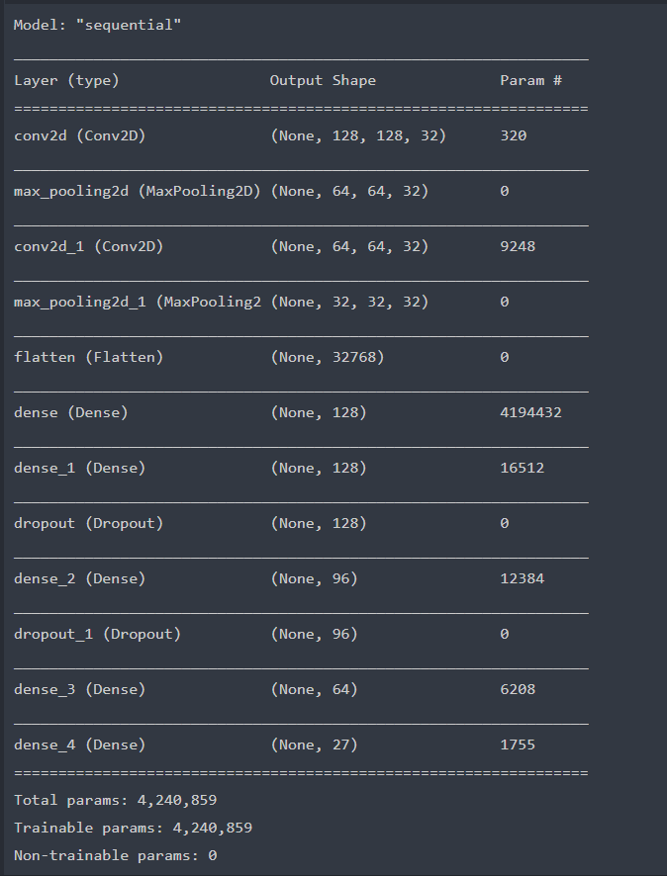
Model Summary

Slide 21
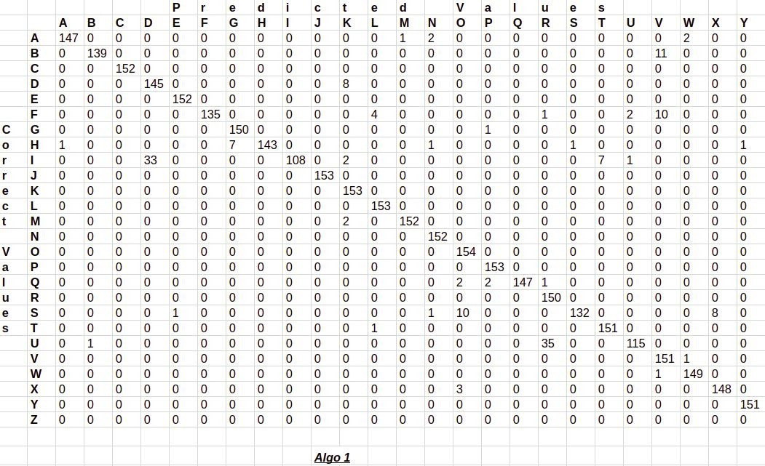
Confusion Matrix for Algo 1

Slide 22
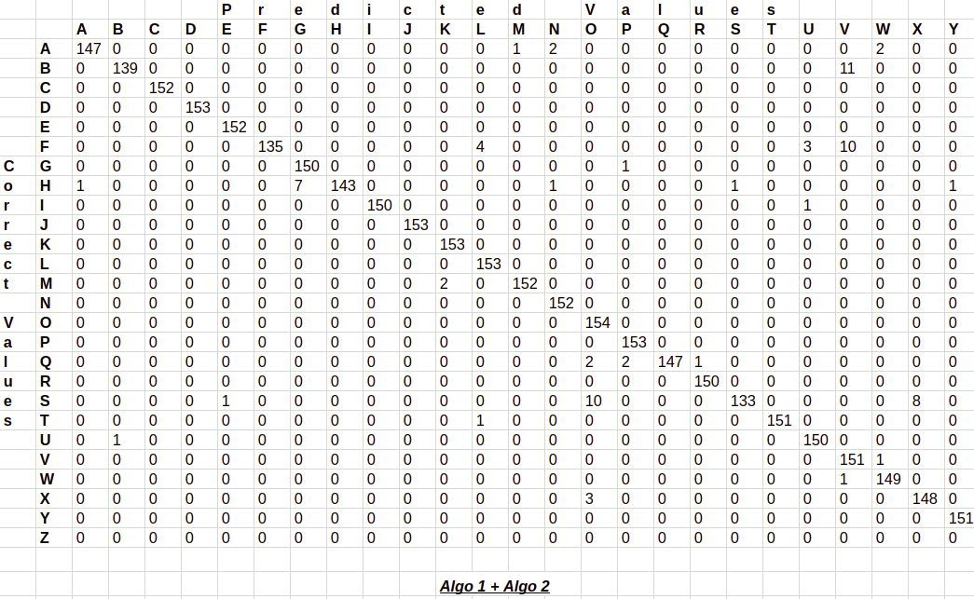
Confusion Matrix for Algo 2

Slide 23
CONCLUSION
To conclude, we used deep learning techniques to process the dataset collected . Using technologies like OpenCV and tensor flow have allowed us classify images through CNN and come up with a model that recognizes sign language with an accuracy of 98%.

Slide 24
REFERENCES
[1] Bikash K. Yadav, Dheeraj Jadhav, Hasan Bohra, Rahul Jain. " Sign Language to Text and Speech Conversion" Sign Language to Text and Speech Conversion. ISSN: 2454-132X Impact Factor: 6.078 (Volume 7, Issue 3 - V7I3-1560).
[2] K Amrutha P Prabu K Amrutha; P Prabu.” ML based sign recognition system” 2021 International Conference on Innovative Trends in Information Technology (ICITIIT).
[3] Mrs s Chandra Gandhi, Aakash raj r, Muhammed Shamil ml, Akhil s, Prabha Shankar. “Real time translation of sign language to speech and text” International Advanced Research Journal in Science, Engineering and Technology. Vol.8, Issue 4, April 2021.
[4] Ankit Ojha, Aayush Pandey, Shubham Maurya, Abhishek Thakur, Dr. Dayananda P “Sign Language to Text and Speech Translation in Real Time Using Convolutional Neural Network.”IJERT NCAIT – 2020 (Volume 8 – Issue 15). 21-09-2020
[5] Carl Jose M. Guingab, Ron Andrew Relayo, Mark Joseph C. Sheng, John Ray D. Tamayo " Using Deep Learning in Sign Language Translation to Text." Proceedings of the International Conference on Industrial Engineering and Operations Management Istanbul, Turkey, March 7-10, 2022

Slide 25
[6] Tiago Oliveira; Paula Escudeiro; Nuno Escudeiro; Emanuel Rocha; Fernando Maciel Barbosa” Automatic Sign Language Translation to Improve Communication” 2019 IEEE Global Engineering Education Conference (EDUCON) [7] Mahesh Kumar N B “conversion of sign language into Text” International Journal of Applied Engineering Research ISSN 0973-4562 Volume 13, Number 9 (2018) pp. 7154-7161 [8] Rajesh Singh, Satyam Shekhar, Shashank Shaurya, Shivang Kumar, Dr. Rekha. K.S “Sign Language to Text” ISSN 2321 3361 © 2020 IJESC Volume 10 Issue No.6 [9] Akshatha Rani K , Dr. N Manjanaik “Sign Language to Text-Speech Translator Using Machine Learning” International Journal of Emerging Trends in Engineering Research volume 9,.No 7,July 2021 [10] Vatsal Patel , Maahi Patel “ Sign To Text Conversion- Helping Aid” International Journal of Scientific Research in Computer Science, Engineering and Information Technology Volume 7, Issue 5,October 2021.

Slide 26
THANK YOU
TEAM :
Nadeem Gulam
Neha Pandey
Medha R
Rakshith V K

